Slide 1
PA Compression Test Software Improvements for M/A-COM
Nick Lalic
VNA Software Developer
Cupertino, CA
September 25th, 2015

Slide 2
PA Compression Test
Three logical parts:
Measurement
Plot generation (on VNA)
Data to Memory (Hold)

Slide 3
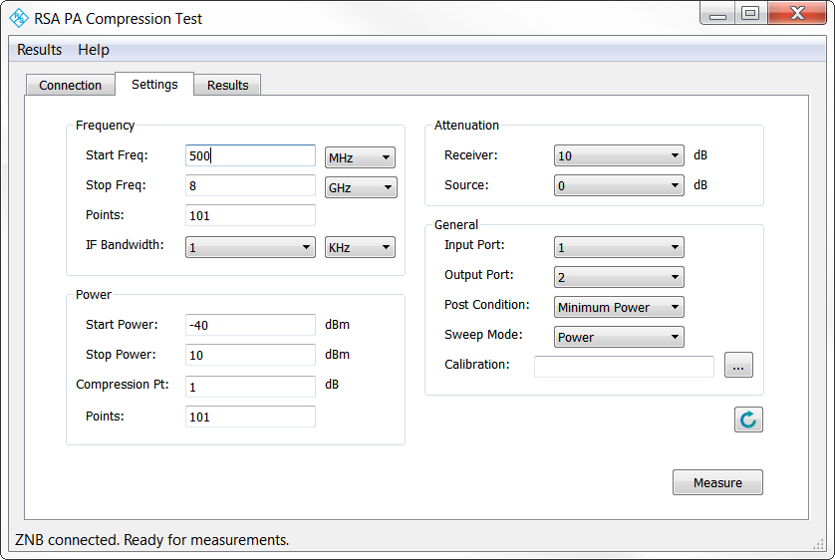
PA Compression Test
Measurement
Sweep power vs frequency
Stop at compression
Accommodate gain expansion
Accommodate pulsed power conditions

Slide 4
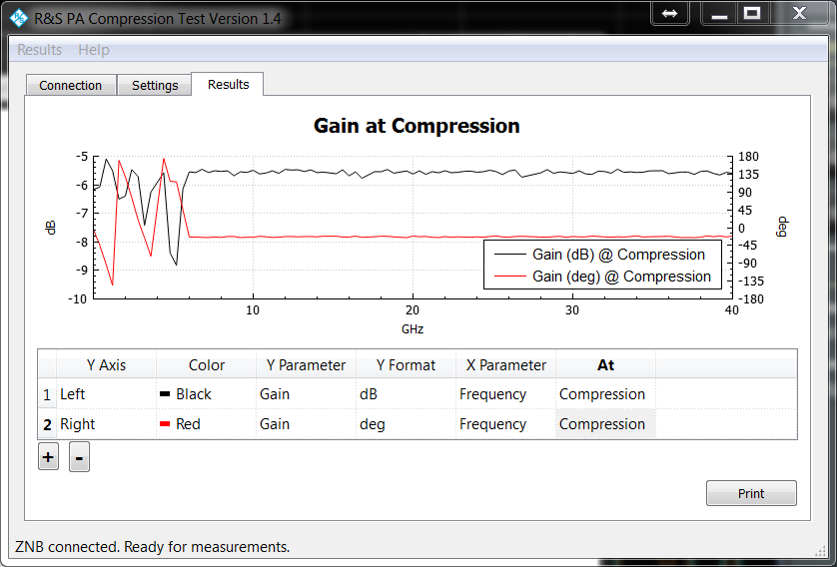
PA Compression Test
Plot Generation
Current plot mechanism

Slide 5
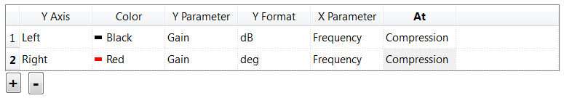
PA Compression Test
Plot Generation
Request: plots on VNA
Question: Are these trace settings sufficient?
Options:
Y Parameter: Input/Output Reflection, Gain, Reverse Gain, Pin, Pout
Y Format: dB, mag, deg, rad, VSWR, dBm
X Parameter: vs Frequency, vs Power
At: Maximum Gain, Compression, Specific Frequency, Specific Power

Slide 6
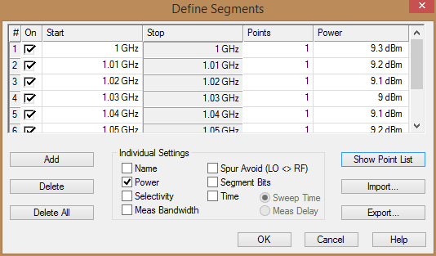
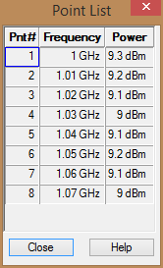
PA Compression Test
Plot Generation:
Write measurement results into two channels with segmented sweeps
Channel 1: Maximum gain
Channel 2: Compression
Benefits of this approach:
Confirm, re-measure results
Use VNA data processing capability
Data export options available
P_{in} = Max. Gain, Compression vs Frequency

Slide 7
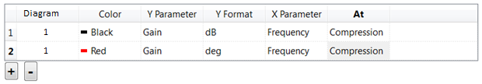
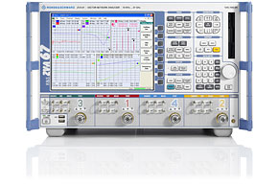
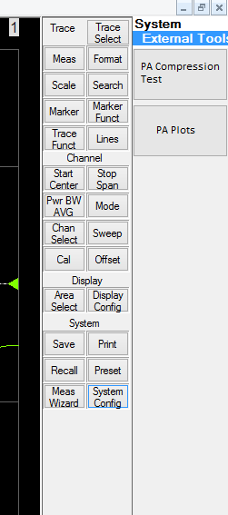
PA Compression Test
Plot Generation
Option 1 – Keep current plot selection tool, but generate plots on VNA
Option 2 – Create a separate tool to generate plots on VNA
Application to save current plot setup, recall plots later
M/A-COM-specific PA plot generation script

Slide 8
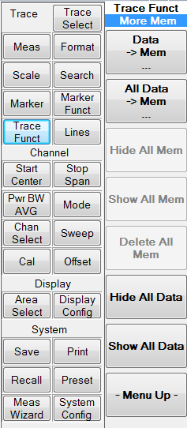
PA Compression Test
All traces data -> memory (hold)
Functionality already built into ZVA:

Slide 9
PA Compression Test
Overall workflow
OR

